Slide 1
More on Software Design

Slide 2
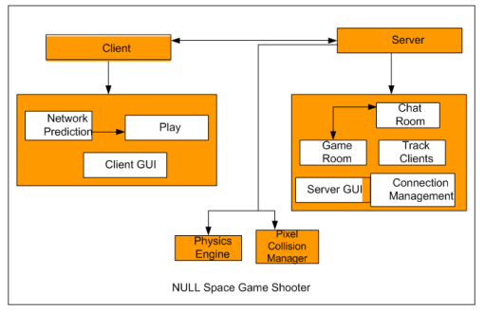
Architectural design-1
Identifying the sub-systems and establishing framework for sub-system control and communication.
Explained using the following architecture

Slide 3
ARCHITECTURE DESIGN – 2
Activities necessary for architectural designing;
System Structuring
Control modeling
Modular decomposition
The output of the architectural design process is an architectural design document.

Slide 4
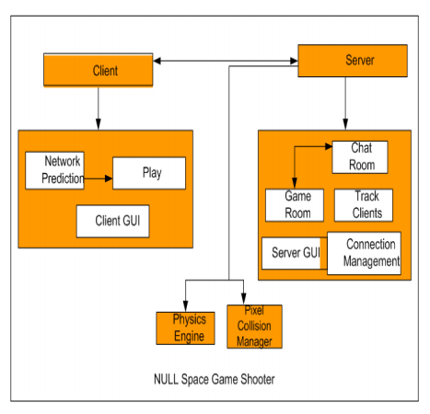
ARCHITECTURE DESIGN – 3
Client and Server are the subsystems that are controlling the other modules.
Other modules are the rectangles in white. E.g., Network Prediction, Play, Chat Room, Game Room etc.

Slide 5
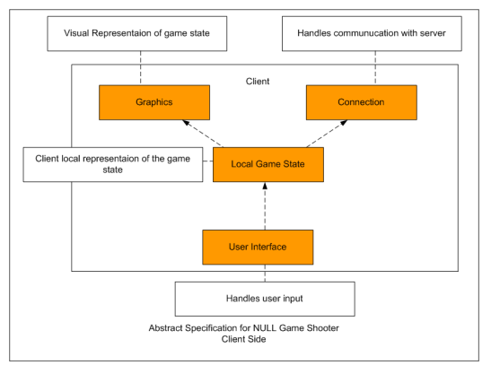
ABSTRACT SPECIFICATION - 1
.
For each sub-system, an abstract specification of the services it provides and the constraints under which it must operate is produced

Slide 6
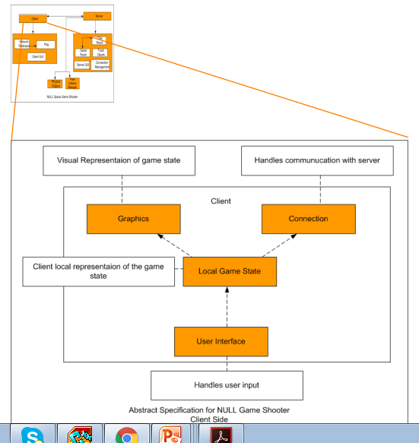
ABSTRACT SPECIFICATION – 2
Orange Boxes are the subsystems.
White Boxes are the services provided by the subsystems.
Services include
Visual Representation
Communication Layer
User I/O
Client Side Copy

Slide 7
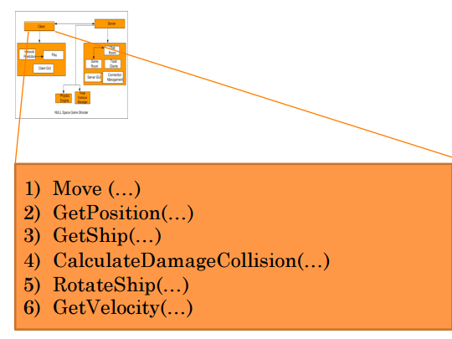
INTERFACE DESIGN - 1
For each sub-system, its interface is designed and documented.
The textboxes below shows a few functions in the interface for the client. These are used by the player object. There will be separate interfaces for each module.

Slide 8
COMPONENT DESIGN - 1
Services are allocated to different components and the interfaces of the components are designed.
This phase entails detailed implementation design of the interfaces that are identified in the interface design.
Services that are allocated to each subsystem are designed as to be implemented.

Slide 9
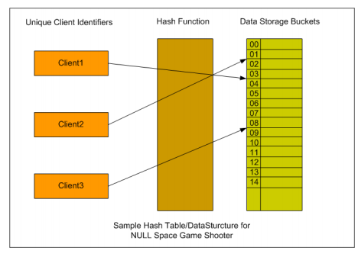
DATA STRUCTURE DESIGN - 1
The data structures used in the system implementation are designed in detail and specified.
Example
Client information is stored in the buckets by mapping them to the buckets via a hashfunction.

Slide 10
Data Dictionary
Data dictionary is the centralized collection of information about data. It stores meaning and origin of data, its relationship with other data, data format for usage etc. Data dictionary has rigorous definitions of all names in order to facilitate user and software designers.
It contains the description of all the elements used in analysis and design models.
Data dictionary is often referenced as meta-data (data about data) repository.
Please go through some templates of DFD from Google.

Slide 11
Software User Interface Design
User interface is the front-end application view to which user interacts in order to use the software. User can manipulate and control the software as well as hardware by means of user interface. Today, user interface is found at almost every place where digital technology exists, right from computers, mobile phones, cars, music players, airplanes, ships etc.
User interface is part of software and is designed such a way that it is expected to provide the user insight of the software. UI provides fundamental platform for human-computer interaction.
UI can be graphical, text-based, audio-video based, depending upon the underlying hardware and software combination. UI can be hardware or software or a combination of both.

Slide 12
The software becomes more popular if its user interface is:
Attractive
Simple to use
Responsive in short time
Clear to understand
Consistent on all interfacing screens
UI is broadly divided into two categories:
Command Line Interface
Graphical User Interface

Slide 13
Command Line Interface (CLI)
CLI has been a great tool of interaction with computers until the video display monitors came into existence. CLI is first choice of many technical users and programmers. CLI is minimum interface a software can provide to its users.
CLI provides a command prompt, the place where the user types the command and feeds to the system. The user needs to remember the syntax of command and its use. Earlier CLI were not programmed to handle the user errors effectively.
A command is a text-based reference to set of instructions, which are expected to be executed by the system.
CLI uses less amount of computer resource as compared to GUI.

Slide 14
CLI Elements
A text-based command line interface can have the following elements:
Command Prompt - It is text-based notifier that is mostly shows the context in which the user is working. It is generated by the software system.
Cursor - It is a small horizontal line or a vertical bar of the height of line, to represent position of character while typing. Cursor is mostly found in blinking state. It moves as the user writes or deletes something.
Command - A command is an executable instruction. It may have one or more parameters. Output on command execution is shown inline on the screen. When output is produced, command prompt is displayed on the next line.

Slide 15
Graphical User Interface
Graphical User Interface provides the user graphical means to interact with the system. GUI can be combination of both hardware and software. Using GUI, user interprets the software.
Typically, GUI is more resource consuming than that of CLI. With advancing technology, the programmers and designers create complex GUI designs that work with more efficiency, accuracy and speed.

Slide 16
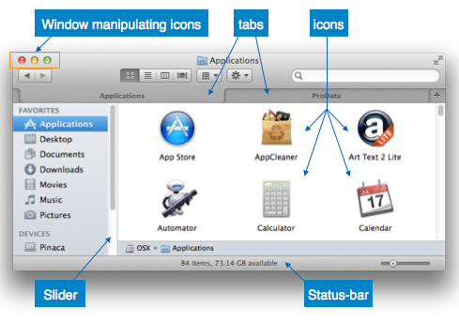
GUI Elements
GUI provides a set of components to interact with software or hardware.
Every graphical component provides a way to work with the system. A GUI system has following elements such as:

Slide 17
Window - An area where contents of application are displayed. Contents in a window can be displayed in the form of icons or lists, if the window represents file structure. It is easier for a user to navigate in the file system in an exploring window. Windows can be minimized, resized or maximized to the size of screen. They can be moved anywhere on the screen. A window may contain another window of the same application, called child window.
Tabs - If an application allows executing multiple instances of itself, they appear on the screen as separate windows. Tabbed Document Interface has come up to open multiple documents in the same window. This interface also helps in viewing preference panel in application. All modern web-browsers use this feature.
Menu - Menu is an array of standard commands, grouped together and placed at a visible place (usually top) inside the application window. The menu can be programmed to appear or hide on mouse clicks.
Icon - An icon is small picture representing an associated application. When these icons are clicked or double clicked, the application window is opened. Icon displays application and programs installed on a system in the form of small pictures.
Cursor - Interacting devices such as mouse, touch pad, digital pen are represented in GUI as cursors. On screen cursor follows the instructions from hardware in almost real-time. Cursors are also named pointers in GUI systems. They are used to select menus, windows and other application features.

Slide 18
Application specific GUI components
A GUI of an application contains one or more of the listed GUI elements:
Application Window - Most application windows uses the constructs supplied by operating systems but many use their own customer created windows to contain the contents of application.
Dialogue Box - It is a child window that contains message for the user and request for some action to be taken. For Example: Application generate a dialogue to get confirmation from user to delete a file.
Text-Box - Provides an area for user to type and enter text-based data.
Buttons - They imitate real life buttons and are used to submit inputs to the software.
Radio-button - Displays available options for selection. Only one can be selected among all offered.
Check-box - Functions similar to list-box. When an option is selected, the box is marked as checked. Multiple options represented by check boxes can be selected.
List-box - Provides list of available items for selection. More than one item can be selected.
Other impressive GUI components are:
Sliders
Combo-box
Drop-down list

Slide 19
User Interface Design Activities
There are a number of activities performed for designing user interface. The process of GUI design and implementation is alike SDLC. Any model can be used for GUI implementation among Waterfall, Iterative or Spiral Model. A model used for GUI design and development should fulfill these GUI specific steps.
GUI Requirement Gathering - The designers may like to have list of all functional and non-functional requirements of GUI. This can be taken from user and their existing software solution.
User Analysis - The designer studies who is going to use the software GUI. The target audience matters as the design details change according to the knowledge and competency level of the user. If user is technical savvy, advanced and complex GUI can be incorporated. For a novice user, more information is included on how-to of software.
Task Analysis - Designers have to analyze what task is to be done by the software solution. Here in GUI, it does not matter how it will be done. Tasks can be represented in hierarchical manner taking one major task and dividing it further into smaller sub-tasks. Tasks provide goals for GUI presentation. Flow of information among sub-tasks determines the flow of GUI contents in the software.
GUI Design & implementation - Designers after having information about requirements, tasks and user environment, design the GUI and implements into code and embed the GUI with working or dummy software in the background. It is then self-tested by the developers.
Testing - GUI testing can be done in various ways. Organization can have in-house inspection, direct involvement of users and release of beta version are few of them. Testing may include usability, compatibility, user acceptance etc.

